Slide 1
Welcome to Paperbark A videogame made by Paperhouse Studios in Thornbury
Notes:
KATE FICAI Welcome and congratulations - you are about to discover how easy it is to use videogames in the classroom for rich engaged learning!
Today we are kicking off with a quick look at Game Literacy then we will take you through an example lesson plan based on Alexander Perrin’s online game Short Trip.

Slide 2
ACMI would like to acknowledge the Traditional Custodians of the lands and waterways of greater Melbourne, the people of the Kulin Nation, and recognise that ACMI is located on the lands of the Wurundjeri people. We also acknowledge First Nations people as the original storytellers of this land and recognise their significant contribution to the contemporary moving image

Slide 3
About Paperbark
Paperbark is a game that tells a charming short story of the bush, a wombat, and a very hot Australian Summer. The player follows a sleepy wombat who spends its day exploring and foraging, while in search for a new home. As the story unfolds, new locations are discovered, the adventure builds with the heat of the day. The natural environment that we will see in Paperbark is designed around Victoria and includes flora and fauna which are native to the state.”

Slide 4
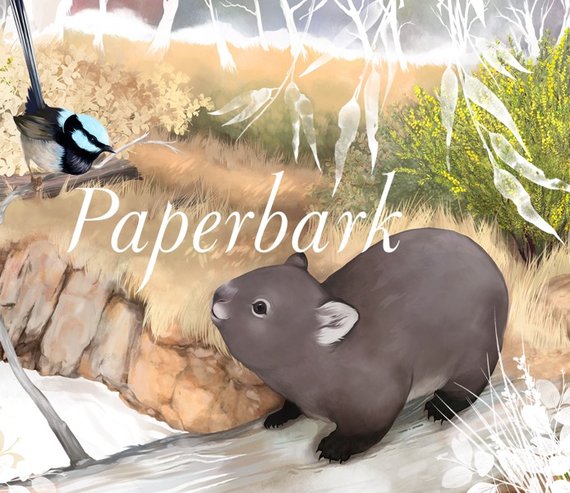
Paperbark Tips
Tap blank area gently to play
Explore, collect & eat
Don’t focus on tokens today
Look for the clues (footprints, arrows, flora fauna, tyre marks)
If in doubt, follow paths
Won’t walk? Turn around
White screen? Wait

Slide 5
Play and observe
One person play and one write what you see. Swap after 10 min.
What natural features do you notice? Flora? Fauna?
What about the atmosphere? Sounds? The environment?

Slide 6
Discuss
Which western season do you think the game is set in?
What do you know about the Western season calendar?
Are the weather conditions we experience easy to summarise with four seasons?

Slide 7
Seven Seasons of the Kulin People Source: Inspiring Victoria
Biderap, Dry Season (Jan-Feb) Iuk, Eel Season (March) Waring, Wombat Season (April-July) Guling, Orchid Season (Aug) Poorneet, Tadpole Season (Sep – Oct) Buarth Gurru, Grass Flowering Season (Nov) Garrawang, Kangaroo-Apple Season (Dec)

Slide 8
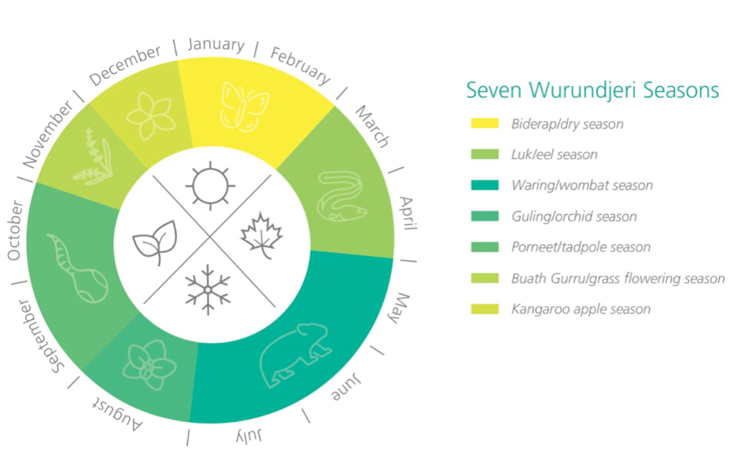
Source: Yarra City Council – Nature Strategy: Protecting Yarra’s Unique Biodiversity 2020 – 2024.

Slide 9
Learning about Country
Country is a prop noun so we use a capital C.
First Nations people refer to Country the same way they refer to a person. For example – Country needs time to heal.
In your notebooks, research these questions:
What is Country?
What is the importance of Country to First Nations peoples and culture?
Notes:
Kate Matthews

Slide 10
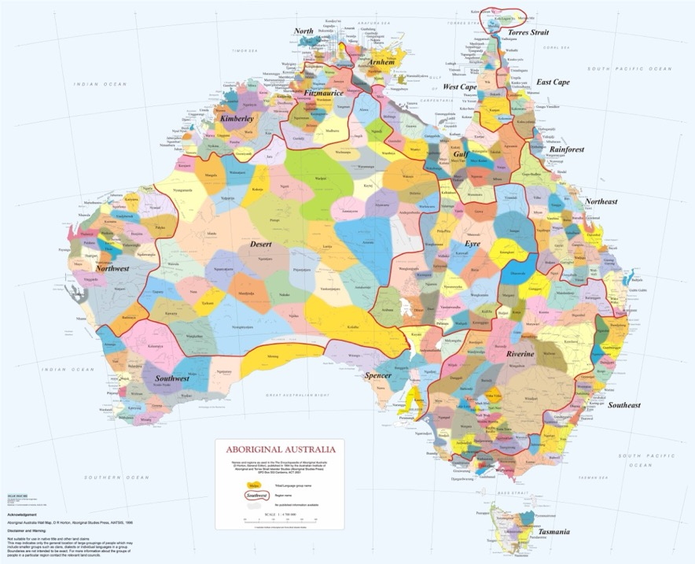
Where are you?
Source: http://nationalunitygovernment.org/pdf/aboriginal-australia-map.pdf.

